Slide 1
Rosters & FERPA
Monitoring enrollment and maintaining confidentiality!
Sheila Jarrell, M.Ed.
Registrar, Yavapai College

Slide 2
Accessing class rosters
Login at www.yc.edu
My Services, Faculty, My Class Roster
Please access your rosters regularly through the first week and AT LEAST once a week throughout the semester.
Report no shows and withdraws!
Monitor your roster to know who has dropped (removed from roster) or withdrawn (withdraw shows on roster) – students can withdraw through October 12.

Slide 3
Monitor Rosters for current enrollment-via www.yc.edu, not Blackboard!

Slide 4
Add/Drop
The deadline for students to add/drop full semester classes:
  Sunday, August 24
For short or late-start classes: the deadline to add/drop is the 6th day after the displayed start date.

Slide 5
No Shows
If you have “no shows” in your class, email enrollmentservices@yc.edu
Include: CRN of the class, student name and Y-number
  Simply copy/paste from your roster into the email
Federal financial aid and Veteran’s Administration regulations require this reporting.

Slide 6
Enrollment during first week
Enrollment will shift through August 24 as students add and drop classes, and as faculty identify no shows.
As the no shows are processed, those seats are made available for other students.
    Submit no shows by 4pm Friday for processing to open those seats.

Slide 7
Timeline
August 18-24: Report no shows
  Students disappear from the roster
  All charges for the class are reversed
Beginning August 25: Withdraw students who have quit participating!
  Students remain on the roster as “Withdrawn”
  There is no refund

Slide 8
Withdrawing students
Withdraw students who have stopped participating: email enrollmentservices@yc.edu
Include: CRN of the class, student name and Ynumber
  AND the last date of participation
  Simply copy/paste CRN and Ynumber from your roster into the email
    Determine last date of participation!
Federal financial aid and Veteran’s Administration regulations require this reporting.

Slide 9
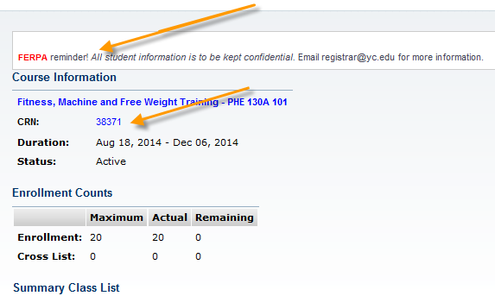
Roster view…

Slide 10
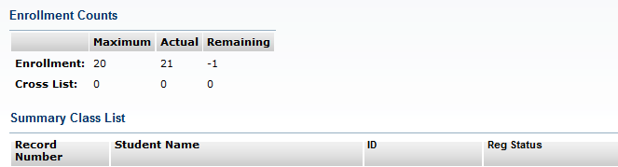

Student list

Slide 11
Student demographic data
Click on any student name on your roster to access the student’s demographic data

Slide 12
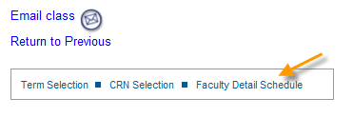
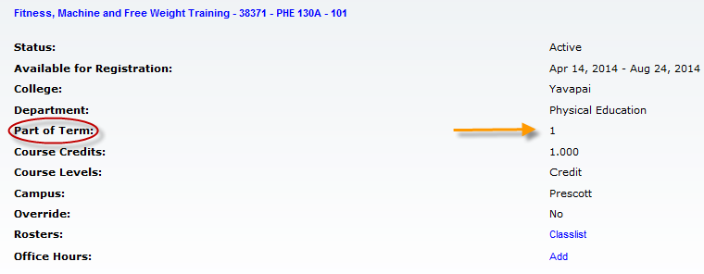
Additional options…

Slide 13
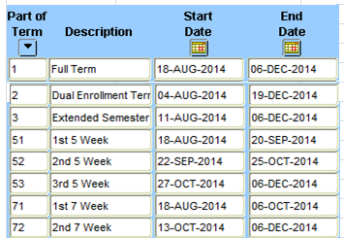
Parts of Term – Fall 2014

Slide 14
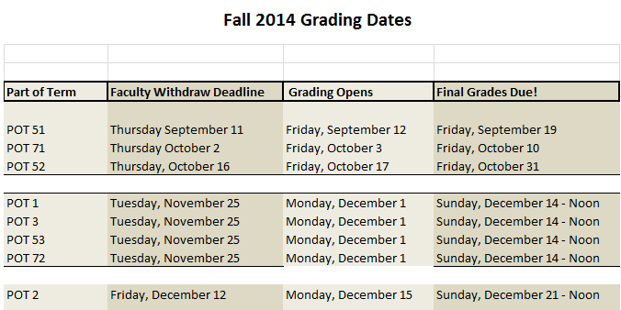
Grading Dates & Deadlines

Slide 15
FTSE: Full-time student enrollment
FTSE calculations are completed every semester on the 45th day, and the state reimburses YC for the enrollment reported.
  Even though we don’t get a lot of money these days, it is still required by the Auditor General.
FTSE for Fall: October 1
  If you monitor your rosters weekly and report no shows and students who quit participating, completing your FTSE roster will be simple.
  Mark your calendars and watch for reminders in late September

Slide 16
FERPA Reminder
FERPA Reminder:
All student education information and records are confidential. (See handout…)
Do not discuss student information with a third party without the students’ signature allowing the release.
Be mindful of your home computer!- Families should not view any rosters or any other educational data

Slide 17
Faculty Support Page!
http://www.yc.edu/v5content/registrar/faculty-support.htm

Slide 18
Questions?
Questions regarding rosters, grades, FTSE or FERPA?
Contact registrar@yc.edu
Call Sheila Jarrell, Registrar, at 928-776-2107
Stop by my office: 1-129D, Prescott Campus!

